Slide 1
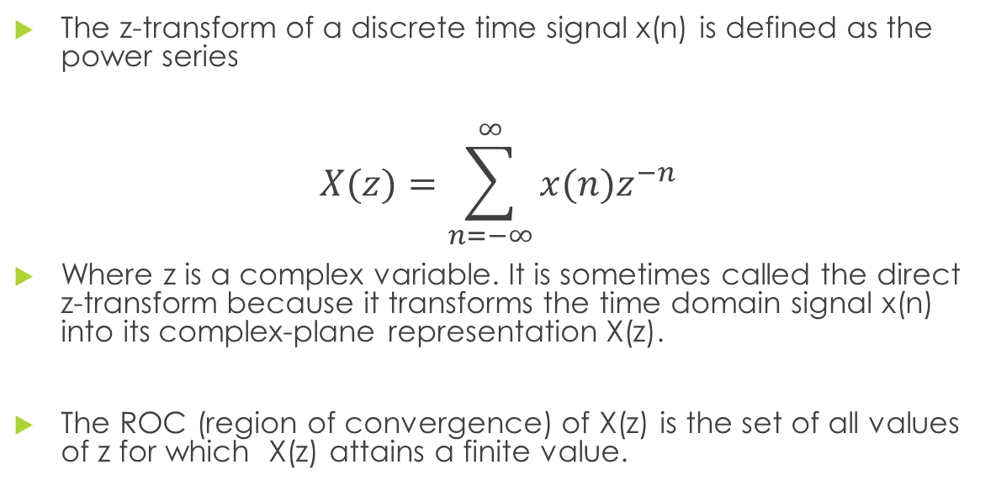
Z-transform
The z-transform of a discrete time signal x(n) is defined as the power series
$$X(z)=\sum_{n=−∞}^{∞}{x(n)z^{−n}}$$
Where z is a complex variable. It is sometimes called the direct z-transform because it transforms the time domain signal x(n) into its complex-plane representation X(z).
The ROC (region of convergence) of X(z) is the set of all values of z for which X(z) attains a finite value.

Slide 2

Z-transform
$$X(z)=\sum_{n=−∞}^{∞}{x(n)z^{−n}}$$
$z=r^{ejθ}$ - polar form of complex variable z
r – magnitude of the complex variable z
r = $\left|z\right|$ = mod z
$$θ=complex argument or phase or angle$$

Slide 3

Examples of Z-transform
Find the z-transform and ROC of the following functions. Plot its ROC
$x\left(n\right)={(\frac{1}{2})}^{n}u(n)$
$x\left(n\right)=u(n)$
$x\left(n\right)=−u(−n−1)$
$x\left(n\right)=δ(n)$
$x\left(n\right)=δ(n−k)$
$x\left(n\right)={7\left(\frac{1}{3}\right)}^{n}u\left(n\right)−{6(\frac{1}{2})}^{n}u(n)$
$x\left(n\right)=−u(−n−1){+\left(\frac{1}{2}\right)}^{n}u\left(n\right)$
$x\left(n\right)={(\frac{1}{3})}^{n}sin⁡(\frac{π}{4}n)u(n)$

Slide 4
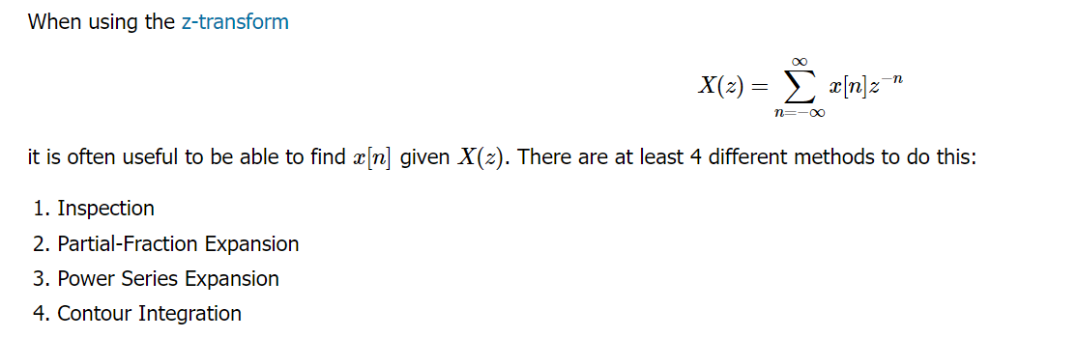
Inverse Z-transform
The inverse Z-transform is defined as the process of finding the time domain signal x(n) from its Z-transform X(z).

Slide 5

Examples of Inverse Z-transform
1. $X(z)=\frac{\frac{1}{4}z^{−1}}{(1−\frac{1}{2}z^{−1})((1−\frac{1}{4}z^{−1})}$
ROC:
$$\left|z\right|>\frac{1}{2}$$
$$\left|z\right|<\frac{1}{4}$$
$$\frac{1}{4}<\left|z\right|<\frac{1}{2}$$
2. $X(z)=\frac{3+2z^{−1}+z^{−2}}{1−3z^{−1}+{2z}^{−2}}$

Slide 6

Examples of Inverse Z-transform
3. $X(z)=\frac{1+3z^{−1}}{1+3z^{−1}+{2z}^{−2}}$
4. $X(z)=\frac{−1+5z^{−1}}{1−{\frac{3}{2}z}^{−1}+{\frac{1}{2}z}^{−2}}$
5. $X(z)=\frac{1+2z^{−1}+z^{−2}}{1−{\frac{3}{2}z}^{−1}+{\frac{1}{2}z}^{−2}}$

Slide 7
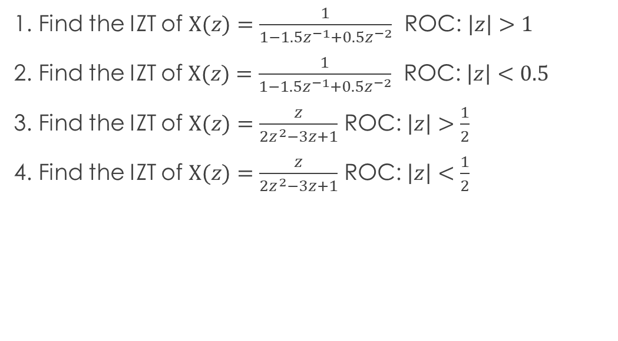
Inverse Z-Transform using Power Series Expansion
1. Find the IZT of $X(z)=\frac{1}{1−1.5z^{−1}+{0.5z}^{−2}}$ ROC: $\left|z\right|>1$
2. Find the IZT of$X(z)=\frac{1}{1−1.5z^{−1}+{0.5z}^{−2}}$ ROC: $\left|z\right|<0.5$
3. Find the IZT of $X(z)=\frac{z}{{2z}^{2}−3z+1}$ ROC: $\left|z\right|>\frac{1}{2}$
4. Find the IZT of $X(z)=\frac{z}{{2z}^{2}−3z+1}$ ROC: $\left|z\right|<\frac{1}{2}$

Slide 8

WHAT ARE FILTERS?
-series of components designed to reduce the amplitude or attenuate of an unwanted frequency in respect to some cutoff frequency

Slide 9
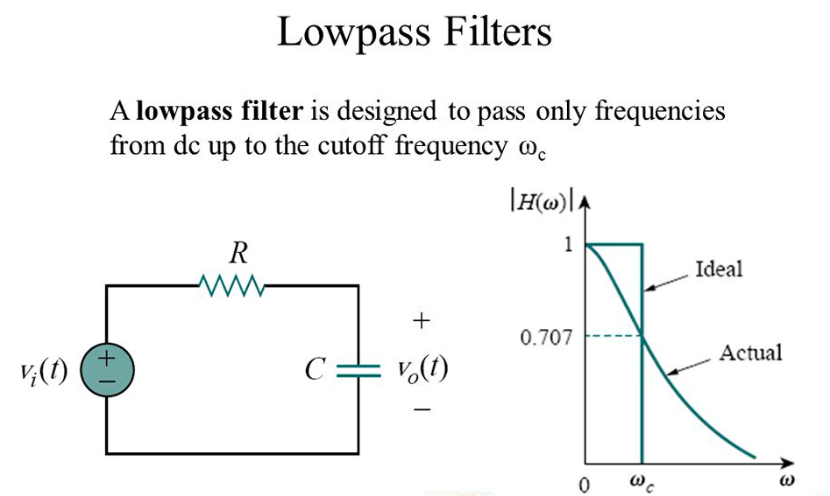
TYPES OF FILTERS
1. Low pass filters - passes lower frequencies and stops high frequencies

Slide 10
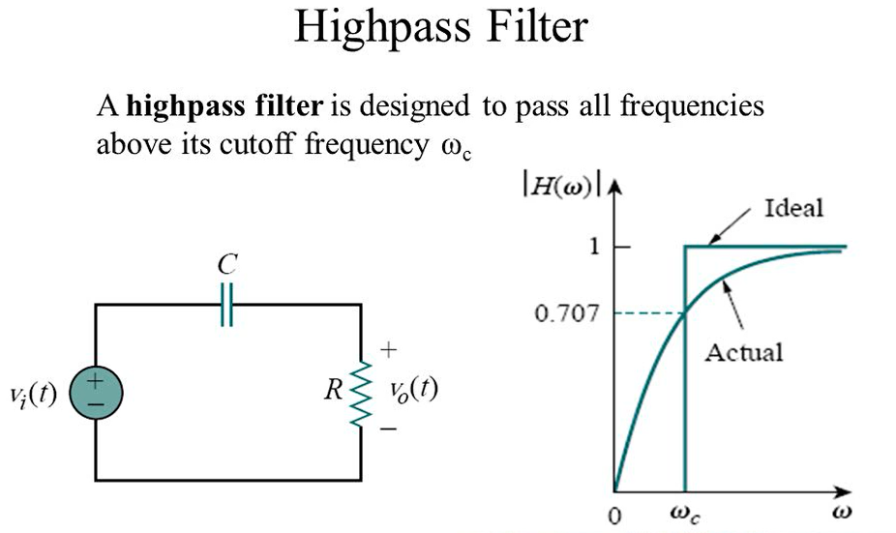
TYPES OF FILTERS
2. High pass filter - pass high frequencies and rejects low frequencies

Slide 11
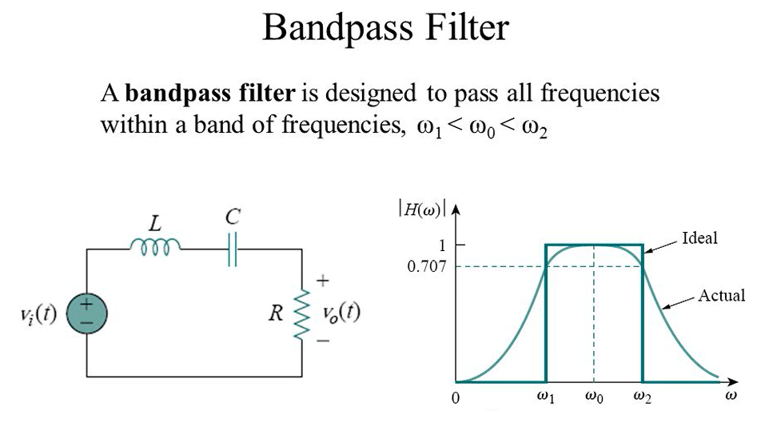
TYPES OF FILTERS
3. Bandpass filter - passes frequencies within a frequency band and blocks or attenuates frequencies outside the band

Slide 12
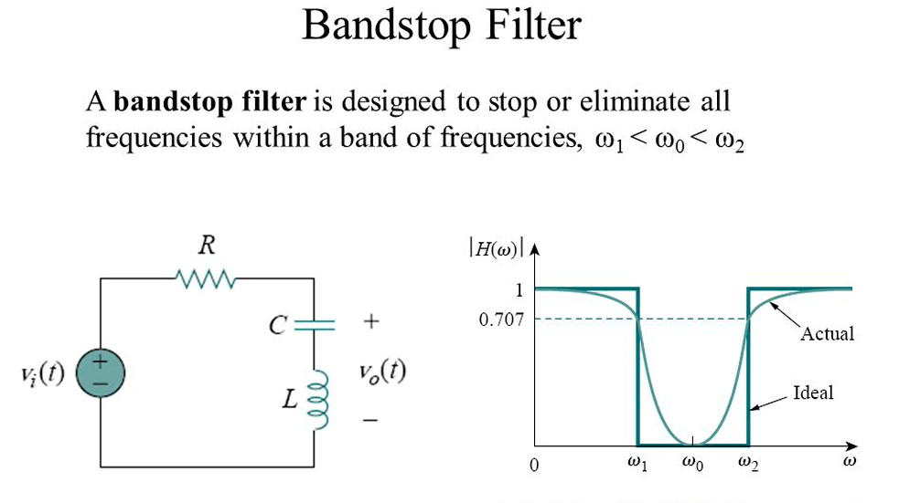
TYPES OF FILTERS
4. Bandstop filter - passes frequencies outside a frequency band and blocks or attenuates frequencies within the band

